Slide 1
19Z601- Machine Learning
Presented by
Ms.Anisha.C.D
Assistant Professor
CSE

Slide 2
Syllabus
INTRODUCTION : Types of Learning - Designing a learning system - concept learning - Find-s Algorithm - Candidate Elimination - Data Preprocessing - Cleaning - Data Scales - Transformation - Dimensionality Reduction. (9)
LINEAR MODELS : Linear Regression Models ,Maximum Likelihood Estimation - Least Squares - Bias-Variance Decomposition - Bayesian Linear Regression - Linear Models for Classification, Probabilistic Generative Models - Probabilistic Discriminative Models - Linear Discriminant Analysis (9)

Slide 3
Syllabus
NEURAL NETWORKS AND DECISION TREES : Feed-forward Networks - Network Training - Delta Rule- Gradient Descent – Error Backpropagation - Regularization in Neural Networks - Generalisation - Decision Tree Learning- Representation - Inductive Bias- Issues (9)
KERNEL AND GRAPHICAL METHODS : Constructing Kernels - Radial Basis Function Networks – Gaussian Processes - Maximum Margin Classifiers - SVM - Bayes Theorem - Naive Bayes - Bayesian Networks (9)

Slide 4
Syllabus
UNSUPERVISED AND REINFORCEMENT LEARNING : Measures of Similarity and Dissimilarity - Clustering - Partitioning methods - KMeans - Hierarchical Methods - Outliers - Reinforcement Learning - Reinforcement Learning Tasks - Q-learning (9)

Slide 5
Text Books and Reference Books
TEXT BOOKS:
1. Tom Mitchell , "Machine Learning", McGraw Hill, 2017.
2. Christopher M Bishop , "Pattern Recognition and Machine Learning Learning", Springer, 2011.
REFERENCES:
1. Ethem Alpaydin , "Introduction to Machine Learning", 3rd Edition, PHI Learning, 2015.
2. Trevor Hastie, Robert Tibshirani, Jerome friedman , "The Elements of Statistical learning", 2nd Edition, Springer, 2017.
3. Kevin Murphy , "Machine Learning - A Probabilistic Perspective", MIT Press, 2012.
4. Yaser S. Abu-Mostafa , "Learning from Data", AML, 2017.

Slide 6
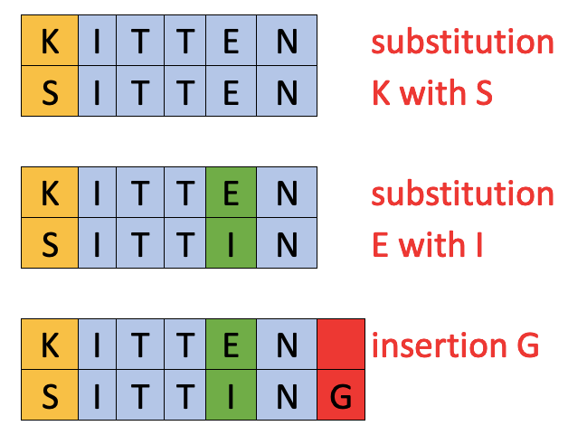
Measures of Similarity and Dissimilarity
Levenshtein Distance
is a string metric for measuring the difference between two sequences.
Informally, the Levenshtein distance between two words is the minimum number of single-character edits (insertions, deletions or substitutions) required to change one word into the other
https://medium.com/analytics-vidhya/levenshtein-distance-for-dummies-dd9eb83d3e09

Slide 7
Levenshtein distance algorithm – Uses
Spell checking
Speech recognition
DNA analysis
Plagiarism detection

Slide 8
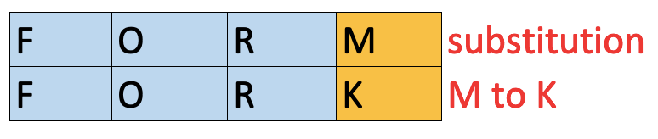
Levenshtein distance algorithm - Example
Levenshtein Distance between FORM and FORK is 1. There is one substitution from M to K.

Slide 9
Levenshtein distance algorithm - Example
Levenstein Distance between KITTEN and SITTING is 3 because there are 3 characters edits.

Slide 10
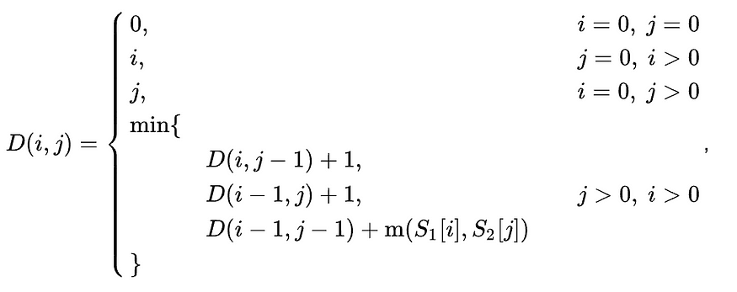
The Levenshtein distance Formula
https://medium.com/@art3330/levenshtein-distance-fundamentals-817b6f7f1718

Slide 11
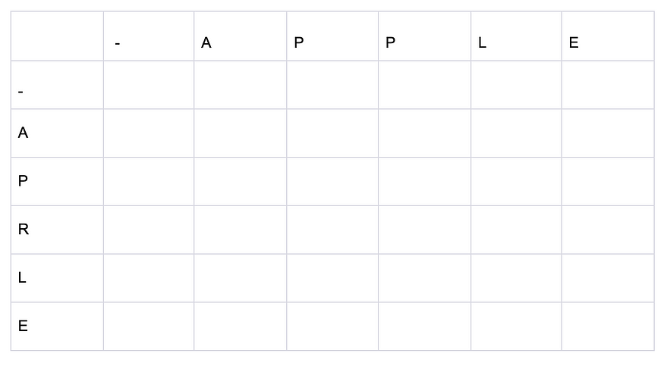
Illustration : The Levenshtein distance between the strings APPLE and APRLE.
Matrix Initialization

Slide 12
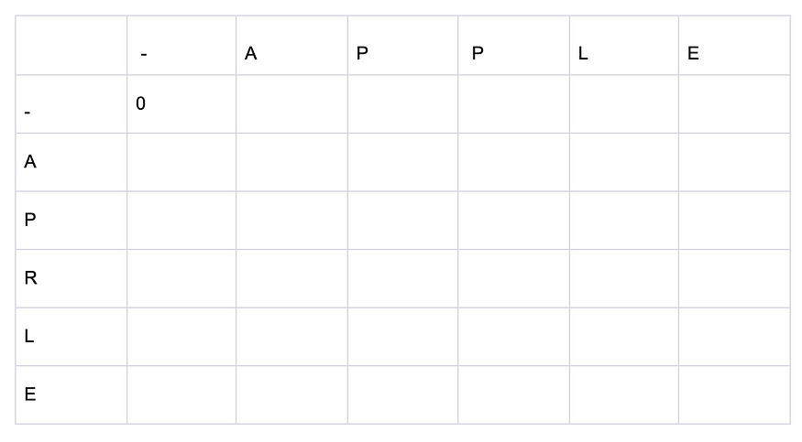
When comparing an empty string with another empty string, it’s evident that the number of operations to turn an empty string into another empty string is zero. Thus, the first value in the matrix will be 0.

Slide 13
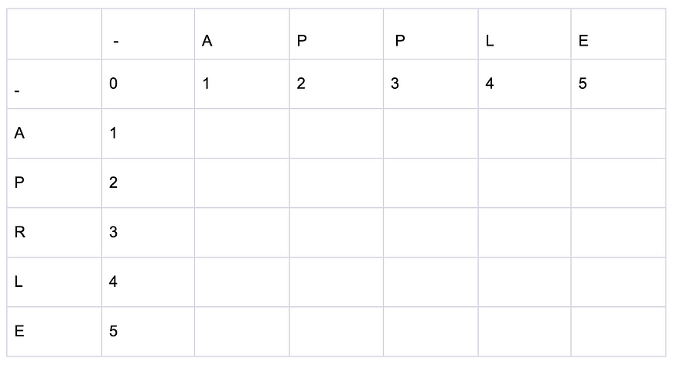
Fill in the first row and the first column.
To calculate all the other cells, use the value of the cell to the left, above, and diagonally above to the left.
But in the case of the first row, there is only the cell to the left.
The cell to the left accounts for deletion operations. Thus, using the formula D(i, j-1) + 1, where i always be 0 since it’s the first row, need to find that each subsequent cell should have a value one greater than the previous one.
This tells that, for example, to make the substring APP into an empty string, need to carry out three deletion operations.
The only difference is that in the case of the column, considering the number of insertion operations. how many insertion operations are needed to turn an empty string into the substring APR.

Slide 14
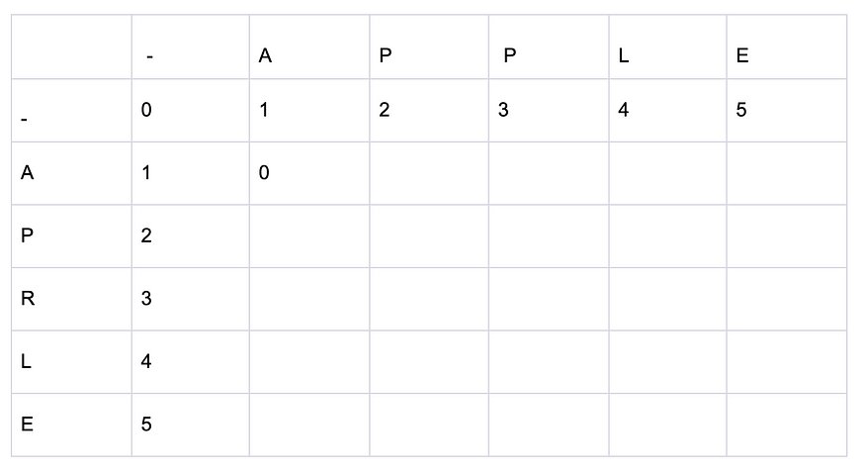
For the cell [1,1], which represents the intersection of the characters A and A,
Need to check the cost of deletion, the cost of insertion, and the cost of substitution.
The given cell has the following values: i = 1, j = 1.
The cost of deletion is [i, j-1] + 1 = [1, 0] + 1 = 1 + 1 = 2.
The cost of insertion is [i-1, j] + 1 = [0, 1] + 1 = 1 + 1 = 2.
The cost of substitution is [i-1, j-1] + m(a, b) = [0, 0] + m(a, b) = 0 + 0 = 0.
Here, m(a, b) is a function that compares two characters, returning 0 if the characters are identical and 1 if they are different. Therefore, min(2, 2, 0) is equal to 0, and hence the value of the cell D(1, 1) is 0.

Slide 15
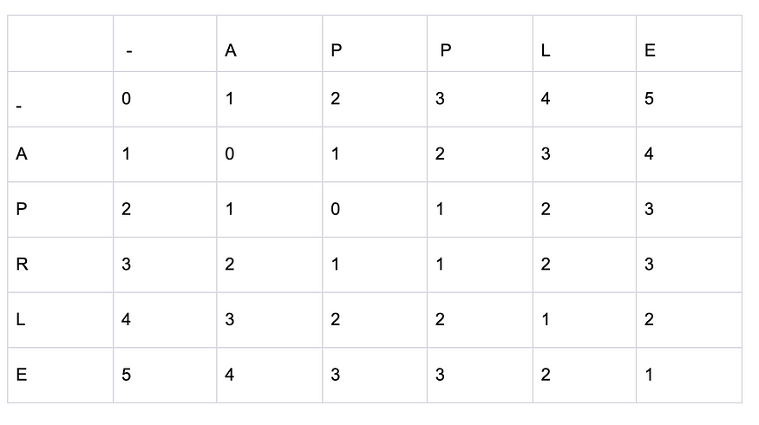
Final Matrix

